Slide 1
Welcome to Simon Marks Jewish Primary School

Slide 2
ETHOS
Simon Marks JPS is a modern orthodox school with a strong connection to Israel.
We welcome children from all backgrounds whose families respect the school’s Jewish ethos.

Slide 3
SHWOING RESPECT MEANS….
RESPECTING THE ETHOS INVOLVES:
Keeping kashrut in school;
Wearing the uniform;
Respecting those who keep Shabbat;
Inclusion at parties;
Participating in Jewish Studies;
Charitable activities;
Making everyone feel welcome.

Slide 4
Kosher means eating food according to Jewish Law.
All food brought into the school must display a Kosher Stamp or be listed in the Kosher Food Guide – a booklet containing kosher approved foods.
This booklet can be obtained from the school office.
KASHRUT / KOSHER
What does it mean?

Slide 5
KASHRUT / KOSHER
Some guidelines
BUYING KOSHER FOOD
Many Kosher products are sold in local supermarkets but Kosher labels must be checked;
All meats/poultry must be bought from a kosher butcher;
All fresh and non pre-packed bakery products must be bought from a kosher bakery;
Kingsmill bread products are Kosher and can be bought from general supermarkets and stores.
WHAT TO AVOID
NO MEAT IN SCHOOL;
NO PORK products allowed;
NO SEAFOOD allowed e.g. prawn, crab, lobster, shrimp, oyster;
NO MIXING OF MILK AND MEAT;
All dairy must display a Kosher Stamp or listed in the Kosher Food Guide.
THE CONFUSING STUFF
Products ‘Suitable for Vegetarians’ does not mean they are kosher!
Please always look for kosher labels.

Slide 6
There is a wide variety of kosher shops in our local area:
Eggstores - Stamford Hill High Road
Berry’s - Stamford Hill High Road and Dunsmure Road
Carmel - Clapton Common
Grodzinski - Clapton Common
Sharon’s Bakery - Stamford Hill High Road and Manor House Tube
Indigs – Old Hill St
Where can I buy kosher food locally?

Slide 7
Kosher Stamps to look out for. These mean that the food products are Kosher.

Slide 8
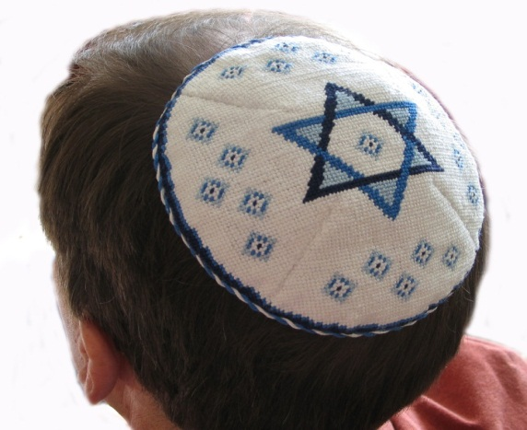
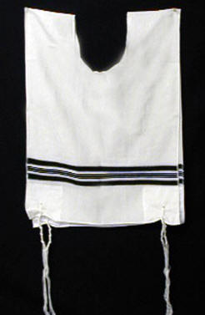
All boys must wear a kippah (skull cap) and tzitzit as a compulsory part of their school uniform.
These are worn as reminders of the presence of G-d. They may be obtained from the school office.
UNIFORM

Slide 9
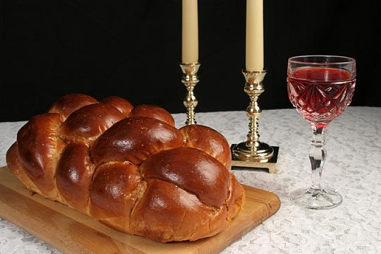
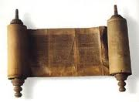
S
SHABBAT
What is it?
It is the Jewish Day of rest where observant Jewish people refrain from certain activities such as driving a car, switching lights on and off and cooking. The day starts from sunset on Friday and ends on sunset Saturday.

Slide 10
BIRTHDAY PARTIES Please plan ahead!
To uphold the inclusive nature of the school, parties should not be held on the Shabbat or Jewish Festivals and all food must be strictly kosher.
Children in Nursery share a birthday cake on birthdays which the school purchases and for which we ask a donation to cover costs.
Please do not bring in cakes or food items to celebrate birthdays further up the school.

Slide 11
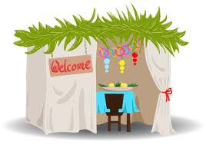
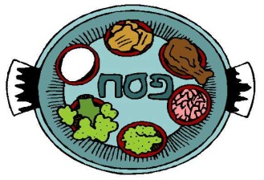
All children learn about Jewish culture, Jewish laws and Jewish festivals.
Parents are invited to celebrate certain Jewish festivals where there is often a show that the children have prepared. The school may sometimes ask children to bring in food items to contribute to the celebration.
JEWISH STUDIES

Slide 12
ISRAEL
ISRAEL
As we are a Zionist school which supports the State of Israel and are proud to celebrate Israel’s Independence.
Modern Hebrew is taught to all children as a Modern Foreign Language.

Slide 13
CHARITY / TZEDEKAH
The Jewish value of regular donation to charities is kept by regular collections of small amounts of money every Friday during a special assembly.
The school supports Israeli, British and international charities.
Each year the school participates in ‘Mitzvah Day’ where children take part in activities and support social action charities.

Slide 14
We look forward to welcoming your child to Simon Marks Jewish Primary School.
We rely on voluntary contributions made to the school’s charitable Trust to support the ethos and wider effectiveness of the school.
Please feel free to contact the office with any queries relating to our ethos.
We hope that you will find our school to have a positive, welcoming and enriching atmosphere.

